Slide 1
Brand Management Presentation
Mohammad Hassan

Slide 2
Agriculture in Pakistan
47.09% of total land is agriculture land – 363,000 sq.km (2018)
Contributes to 18.9% of GDP
Responsible for 42.3% of total employment
Important source of FDI
Includes major exports
Stimulates growth in other sectors – fertilizer industry, manufacturing etc.
64.05% of total female employment
Increasing demand for agriculture products – 2.0% population growth annually

Slide 3
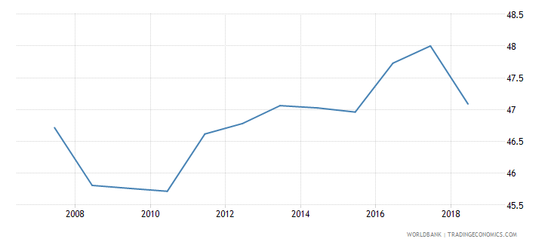
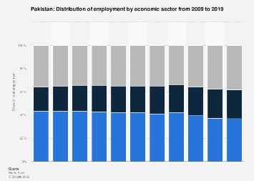
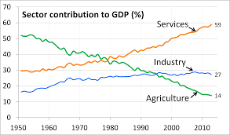
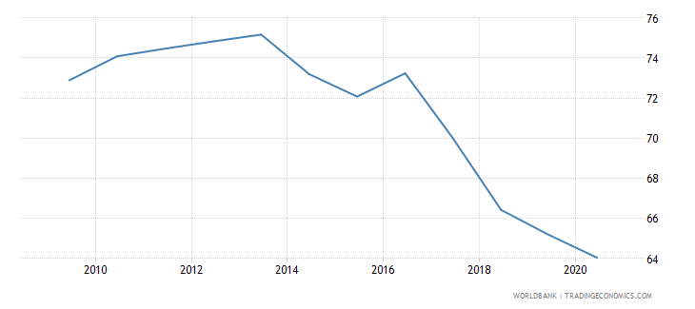

Slide 4
Overall Problems faced by the Agriculture Industry
Neglected due to political economy – 22 families
Lack of irrigation facilities – 28% of cultivable land is irrigated
poor crop yields – outdated farming, obsolete technology, poor quality seeds
Poor Post-Harvest Infrastructure – lack of cold storage, silos, etc.
Underdeveloped and unregulated markets
Lack of access to markets
Liquidity crisis resulting in middleman (Arthi) power

Slide 5
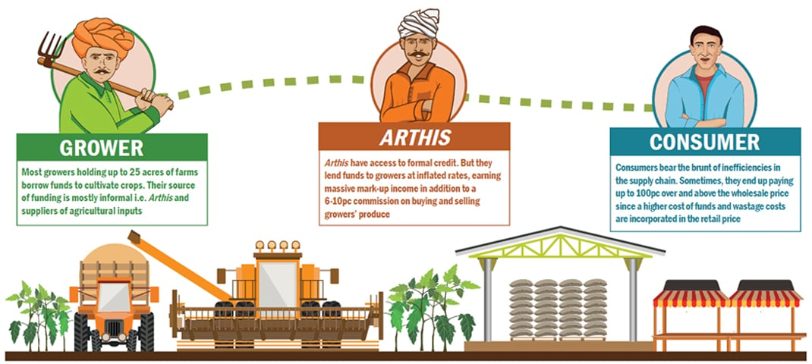
The Market Access Crisis
Most of the agriculture industry is rural but market is urban/semi-urban.
A huge and complex Value Chain.
Farmers lack resources to commute to markets.
Farmers lack knowledge to negotiate with markets.
This leads to Arthi power.

Slide 6
The Middleman (Arthi) Crisis
Arthi’s are loan sharks as well as commission agents
Sell agriculture supplies to farmers at 33.33% mark-up on credit
Give loans to farmers at 50% interest
Purchase harvest from farmer at lower-than-market rates
Sell harvest to market/consumer at market rate
Farmers get 40% of retail price, Arthi’s get 43%, remaining 17% include expenses such as transportation etc. usually paid by the Arthi.

Slide 7
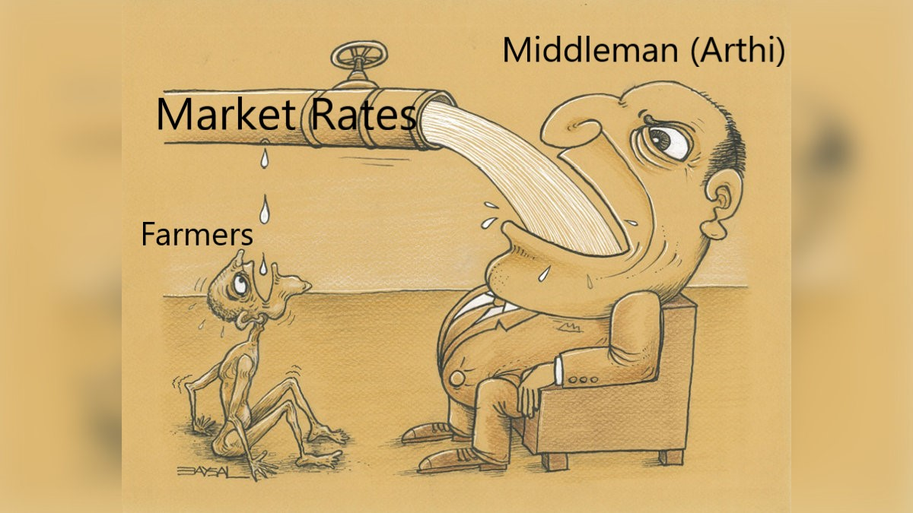
The Middleman (Arthi) Crisis

Slide 8

KISAAN-HUB

Slide 9
About the Brand
Brand Promise – To improve the welfare of farmers and work towards creating a sustainable agriculture ecosystem.
Tagline – Half the input, twice the output!
How:
Disrupting the inefficient and unfair supply chain
A better and less exploitative alternative to the Arthi
Connecting the farmers with the right buyers
Distributing the harvest to B2B and B2C buyers
Building an infrastructure/network for market access
One stop solution to all the problems of a farmer – technology, paperwork, etc.

Slide 10
About the Brand
Reason to believe
The team at Kisaan-Hub has an already established network in rural and urban markets
Prior experience with farming
The brand uses technology and modern methods to ensure effective decision making at every stage
Established partnerships with government and non-government organizations relevant to farming
Why Kisaan-Hub
First brand committed to solving the market and arthi issues of farmers
Solutions to all kinds of problems – reduced profits, poor supplies, post-harvest certainty

Slide 11
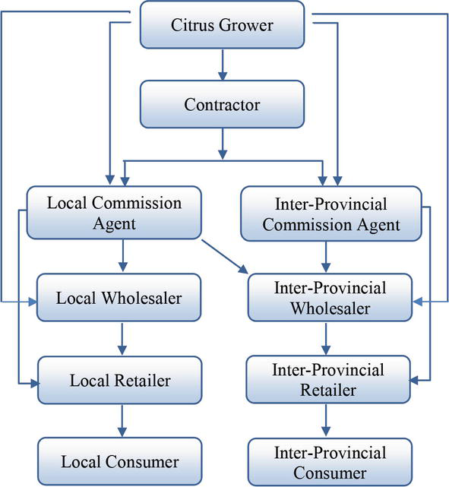
Transformer: Traditional Value Chain

Slide 12
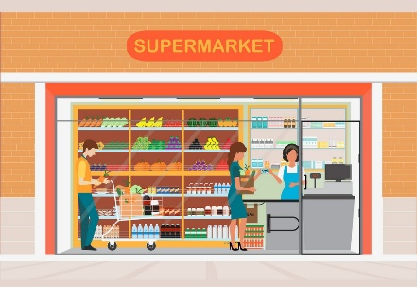
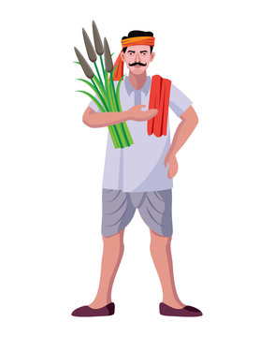


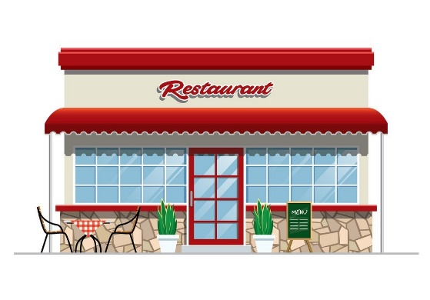
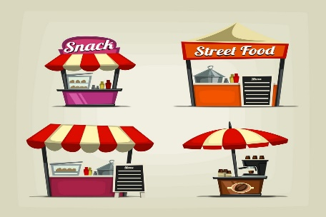
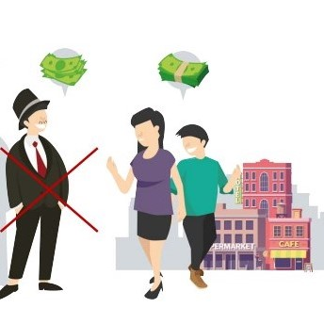
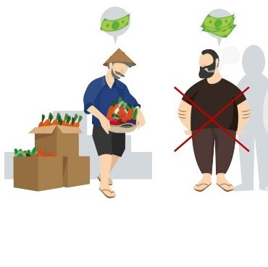
Transformer: The Kisaan-Hub Value Chain

Slide 13

Brand Identity
Brand Essence – Sustainability, Growth, and Empowerment.
Brand Mantra – Agriculture For All.
Visual Style
Logo
Colors
White – signifying honesty, sincerity, reliability, and security.
Green – signifying nature, health, success, and growth.
Style attributes
Classic, Mature, Masculine, Sophisticated, Economical, and Organic.

Slide 14
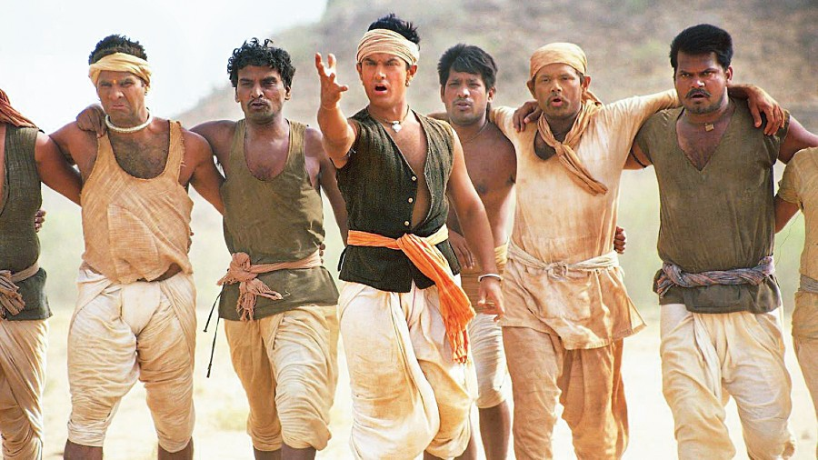
Fictional Representation:Good Guys VS Bad Guys
Fictional representation of what our brand personifies.
KisaanHub – Protagonist.
The villagers – Farmers; our target audience.
The British – Middlemen – Arthis – who exploit the the villagers – farmers.

Slide 15
Brand Personality
Industry Meetup
Sincere and honest person
Altruistic nature
Socially conscious and responsible
CSR oriented organization
Goals are to uplift agriculture industry and help farmers grow
This not That
Modern
Sincere
Serious
Competent

Slide 16
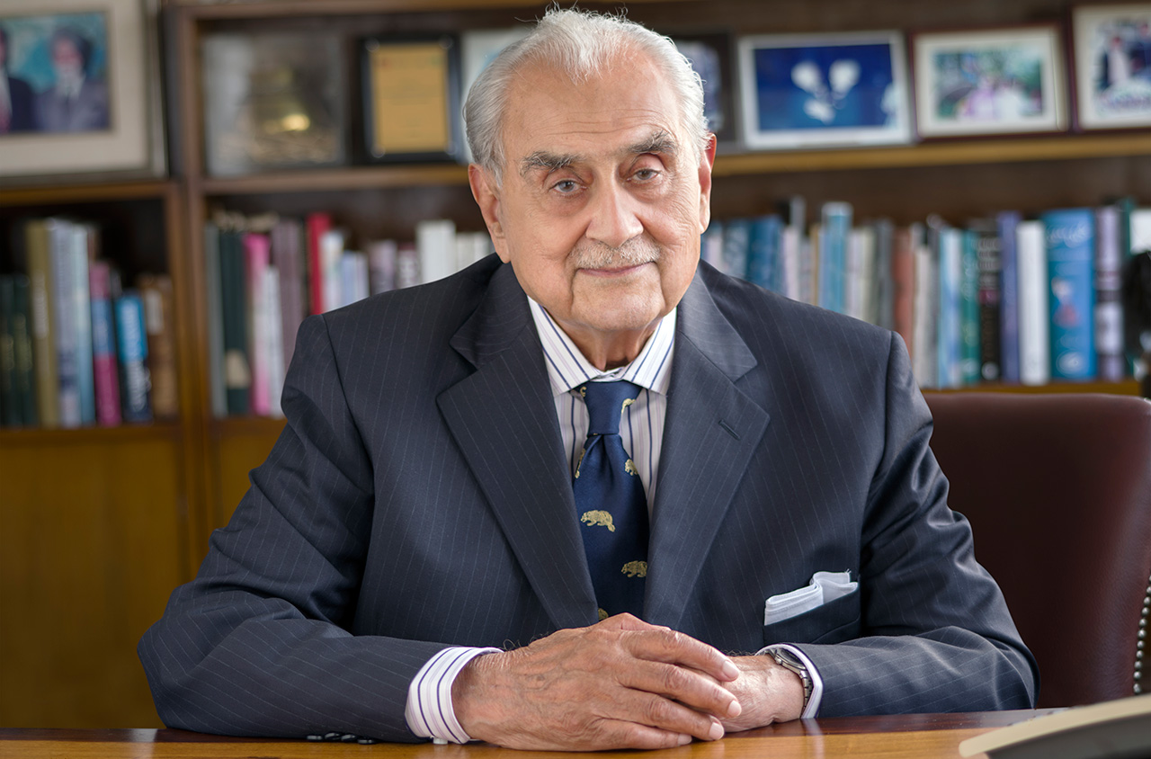
Industry Meetup
Syed Babar Ali
Founder of Packages Ltd., MilkPak Ltd., and LUMS
Philanthropist.
Belongs to an agriculture background family.
Made his initial fortunes from agriculture.
Can act as an inspiration to our customers and target audience that with the right decisions and guidance they too achieve all their dreams.

Slide 17
Pricing and Marketing Strategy
Pricing Strategy
10% commission on profits instead of revenues for KisaanHub
Bigger emphasis on building long-term relationships during first 2 years rather than profitability of the brand
KisaanFund – 5% commission on profits, 30% to investor until paid back, and 65% to farmer
KisaanSupply – Wholesale storage and transportation costs + 5-10% markup based on volume
Marketing Strategy
Supply chain strategy – work in liaison with National Logistics Company and Pakistan Post
60% marketing budget allocated to sales force personnel
20% marketing budget allocated to print media using features in local language newspapers
20% marketing budget allocated to electronic media – TV, Social media, and radio etc
TV is watched by almost everyone at home, bus stops, etc.
Social media has become increasingly popular in small towns and villages
Radio is an inexpensive medium, has penetration in villages, listened by commuters, and can be easily translated.
Future sponsoring of agriculture trade shows and local sports festivals

Slide 18
Feedback
Local farmers POV – Much needed service, would solve almost all problems for smallholders as well as large scale farmers.
Local retailers POV – Seemed happy that they could get lenient rates from direct distribution rather than the rates offered by Arthi’s.
Agrinomist POV – Would be beneficial for the economy as a whole. The brand could potentially uplift the agriculture industry and rural community.
Marketer’s POV – Appreciated the idea and the conviction. Skeptical about the success potential because of lack of education and the power currently held by the Arthi.
Gained their trust and convinced them by highlighting our personal experience with the industry and the market, and telling them about our strategic partners; government agencies.

Slide 19
The Spin
Nestle
Why we look up to?
Similar brand personality; sincerity, competence
Similar vision; health and sustainability
Strong CSR
What if Nestle acquires or invests in KisaanHub?
Access to huge amounts of monetary funds and powerhouse backing
Huge supply chain network can be accessed
Access to existing suppliers, distributors, and business partners
Nestle’s storage facilities can be used to provide warehousing and cold storage
Global outreach

Slide 20
Future Strategy
Aim to grow operations and add further services to the business.
Partnership with international firms to import machinery and agri products.
KisaanHub Consultancy
Agriculture experts providing training and guidance to small holders.
Strategic partnerships with Netherland’s agriculture industry to bring in insight.
KisaanFund
Lending platform to bring local and foreign direct investment.
Solution to farmers’ financing problems.
KisaanSupply
Supply chain infrastructure.
E-warehousing
B2B and B2C distribution and supply of harvest and products.
Making KisaanHub app-based in future considering education levels.

Slide 21
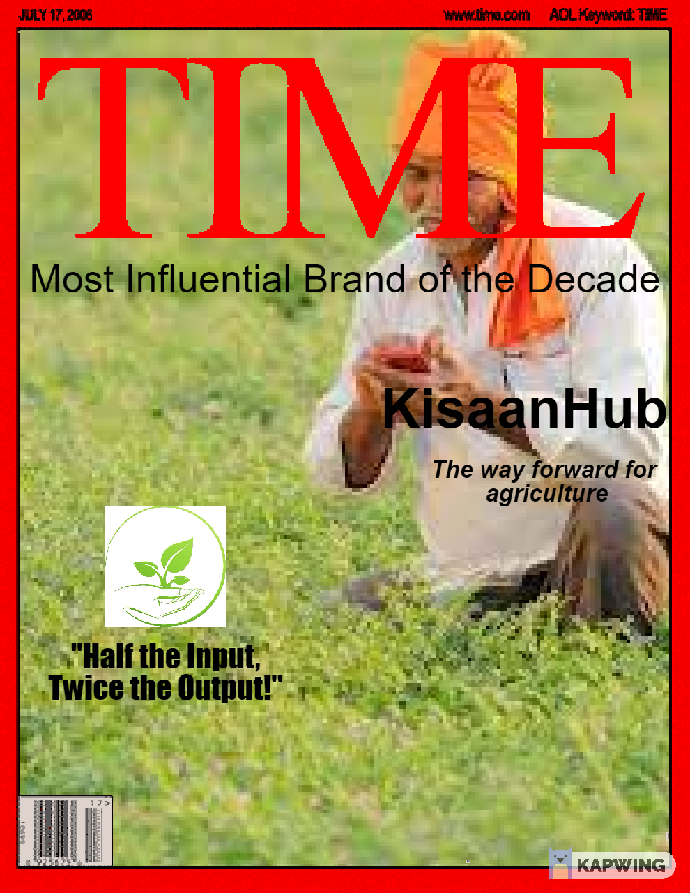
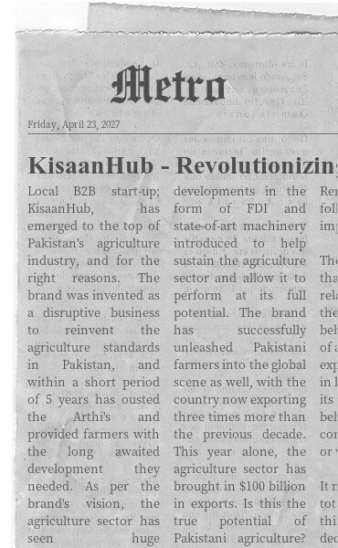
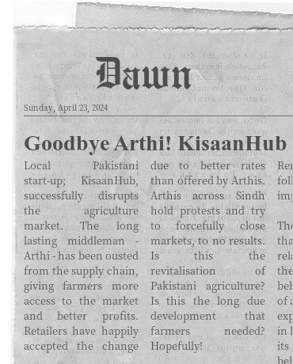
Front Page News

Slide 22
THANK YOU!

